Slide 1
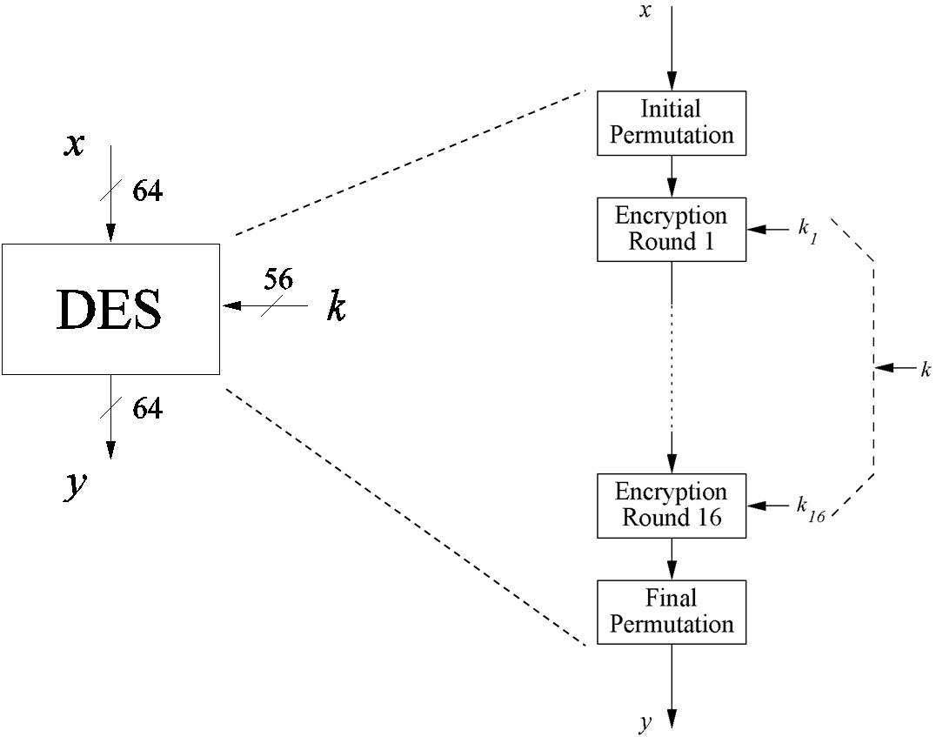
Data Encryption Standard (DES)
Notes:
The plaintext is 64 bits in length and the key is 56 bits in length; longer plaintext amounts are processed in 64-bit blocks. The DES structure is a minor variation of the Feistel network. There are 16 rounds of processing. From the original 56-bit key, 16 subkeys are generated, one of which is used for each round.
The process of decryption with DES is essentially the same as the encryption process. The rule is as follows: Use the ciphertext as input to the DES algorithm, but use the subkeys Ki in reverse order. That is, use K16 on the first iteration, K15 on the second iteration, and so on until K1 is used on the 16th and last iteration.
DES Slides updated. Please go through and deepen your understanding using:
DES Animation - http://kathrynneugent.com/des.html
Walkthrough examples posted: 04.1 DES-Walkthrough-Example.pdf & 04.2 DES-Example.xlsx

Slide 2
Outline
Introduction to DES
Overview of DES Algorithm
Internal Structure of DES
Security of DES
Notes:
Decryption

Slide 3
Introduction to DES

Slide 4
Classification of DES in the Field of Cryptology
Cryptology
Cryptography
Cryptanalysis
Symmetric Ciphers
Asymmetric Ciphers
Protocols
Block Ciphers
Stream Ciphers
You are here!
Notes:
P = plaintext block
C = ciphertext block
Encrypt P with key K to get ciphertext C
C = E(P, K)
Decrypt C with key K to get plaintext P
P = D(C, K)

Slide 5
DES Facts
Data Encryption Standard (DES) encrypts blocks of size 64 bits
Developed by IBM based on the cipher Lucifer with input from the National Security Agency (NSA)
Standardized 1977 by the National Bureau of Standards (NBS) today called National Institute of Standards and Technology (NIST)
Most popular block cipher until 2000
By far best studied and cryptanalized symmetric algorithm
Nowadays considered insecure due to the small key length of 56 bit
But 3DES yields very secure cipher, still widely used today.
Replaced by the Advanced Encryption Standard (AES) in 2000
Notes:
, the design criteria for DES have not been published
DES developed in 1970’s
Based on IBM’s Lucifer cipher
DES was U.S. government standard
Development of DES was controversial
NSA secretly involved
Design process was secret
Key length reduced from 128 to 56 bits
DES is a Feistel cipher with…
64 bit block length
56 bit key length
16 rounds
48 bits of key used each round (subkey)
Round function is relatively simple
Security depends heavily on “S-boxes”
Each S-box maps 6 bits to 4 bits

Slide 6
Block Cipher Primitives: Confusion and Diffusion
Claude Shannon established that two primitive operations are required to build strong encryption algorithms:
Confusion: An encryption operation where the relationship between the key and the ciphertext is obscured - Commonly achieved using substitution
- Mixing the key values during the repeated rounds of encryption - Small change in key → large change in ciphertext
Diffusion: An encryption operation where the influence of one plaintext symbol is spread over many ciphertext symbols with the goal of hiding statistical properties/patterns of the plaintext
- Commonly achieved using bit permutation
Small change in plaintext → large change in ciphertext
Alternate both confusion and diffusion functions to build so called product ciphers
Notes:
Substitutions
Each plaintext element or group of elements is uniquely replaced by a corresponding ciphertext element or group of elements
Permutation
No elements are added or deleted or replaced in the sequence, rather the order in which the elements appear in the sequence is changed
Hides patterns within the message
- Confusion
o Relationship between key and ciphertext
o Small change in key → large change in ciphertext
o XOR is not sufficient; one-to-one
o Key schedule
- Diffusion
o Relationship between message and ciphertext
, which is found in both AES and DES.
Confusion:
•Seeks to make the relationship between the statistics of the ciphertext and the value of the encryption key as complex as possible
•Even if the attacker can get some handle on the statistics of the ciphertext, the way in which the key was used to produce that ciphertext is so complex as to make it difficult to deduce the key

Slide 7
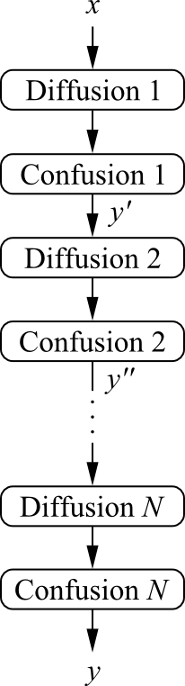

Product Ciphers
Most of today‘s block ciphers are product ciphers as they consist of rounds which are applied repeatedly to the data
Can reach excellent diffusion: changing of one bit of plaintext results on average in the change of half the output bits
Example:
single bit flip
many bit flips

Slide 8
Overview of DES Algorithm

Slide 9
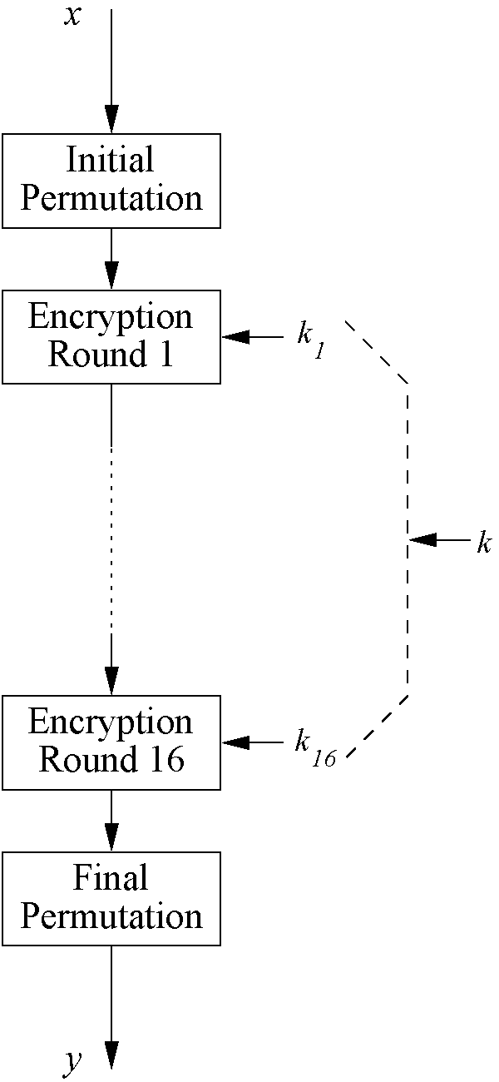
Overview of DES Algorithm
Encrypts blocks of size 64 bits
Uses a key of size 56 bits
Symmetric cipher: uses same key for encryption and decryption
Uses 16 rounds which all perform identical operation
Different subkey in each round derived from main key
Each round uses a generated subkey and the output of previous round
Notes:
Plaintext and ciphertext consist of fixed-sized blocks
Ciphertext obtained from plaintext by iterating a round function
Input to round function consists of key and output of previous round
Usually implemented in software
Permutation = function that “rearranges” the elements

Slide 10
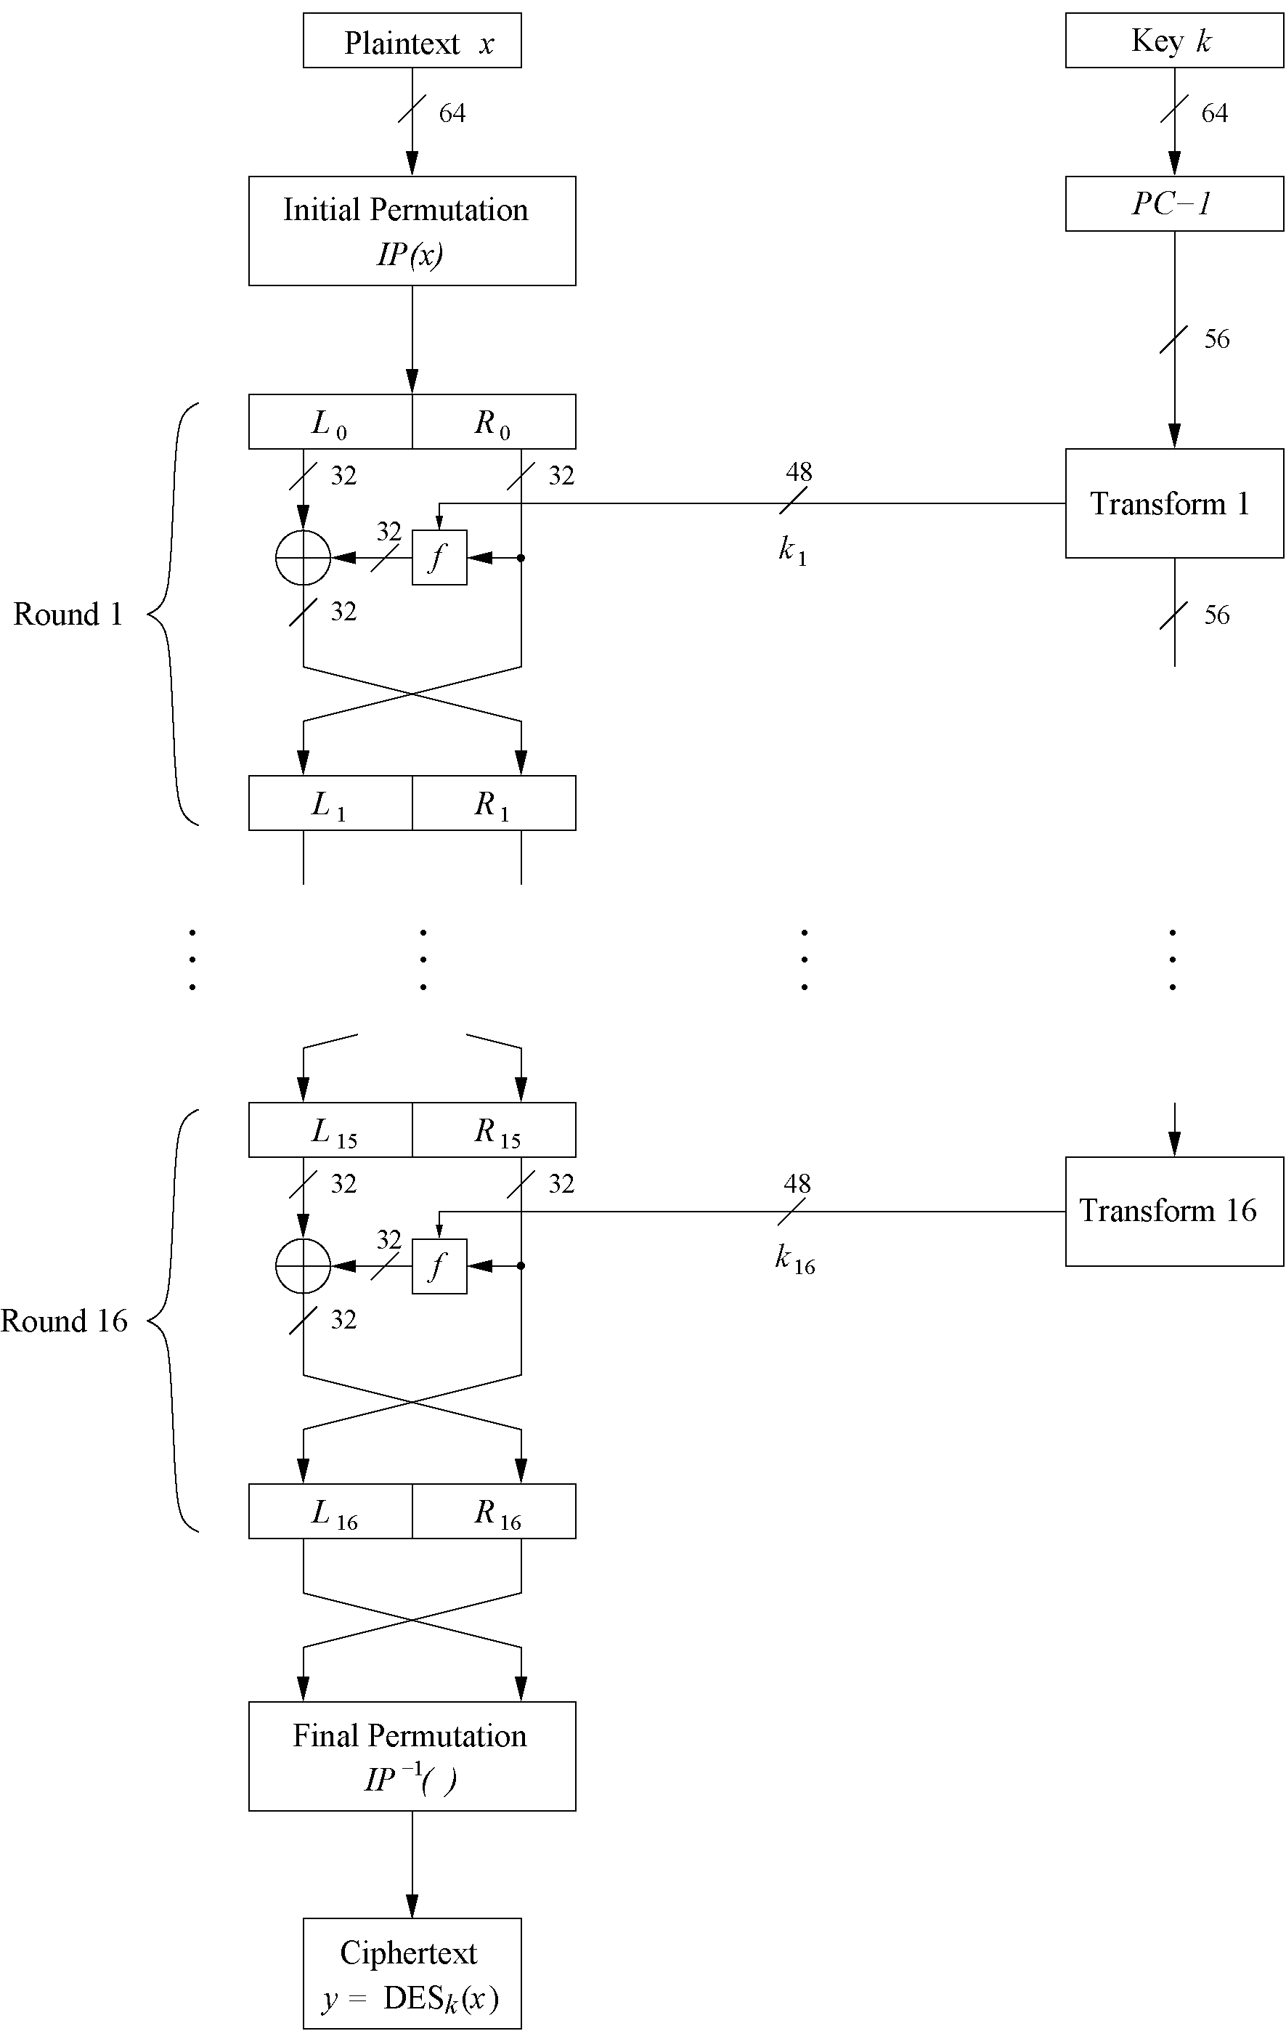
Encryption Round

Slide 11
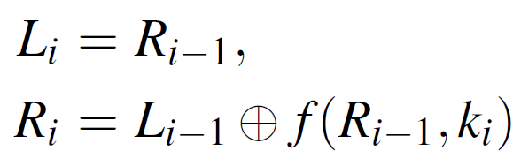
DES Feistel Network (1)
DES structure is a Feistel network which an approach adopted by many block ciphers
Advantage: encryption and decryption differ only in keyschedule
subkey1
Bitwise initial permutation, then 16 rounds
Plaintext is split into 32-bit halves L_{i} and R_{i}
R_{i} is fed into the function f, the output of which is then XORed with L_{i}
Left and right half are swapped
Rounds can be expressed as:
Notes:
Feistel cipher is an approach adopted by many block ciphers
Split plaintext block into left and right halves:
P = (L₀, R₀)
For each round i = 1, 2, ..., n, compute
L_{i} = R_{i−1}
R_{i} = L_{i−1} ⊕ F(R_{i−1}, K_{i})
where F is round function and K_{i} is subkey
Ciphertext: C = (L_{n}, R_{n})

Slide 12
The DES Feistel Network (2)
L and R swapped again at the end of the cipher, i.e., after round 16 followed by a final permutation
subkey16

Slide 13
Internal Structure of DES

Slide 14
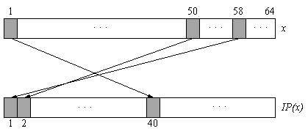
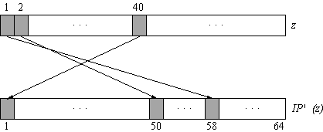
Initial and Final Permutation
Bitwise Permutations
Described by tables IP and IP⁻¹
Initial Permutation
Final Permutation
https://en.wikipedia.org/wiki/DES_supplementary_material
Notes:
Inverse operations
An initial permutation before round 1
Halves are swapped after last round
A final permutation (inverse of initial perm) applied to (R₁₆, L₁₆)
None of this serves any security purpose

Slide 15
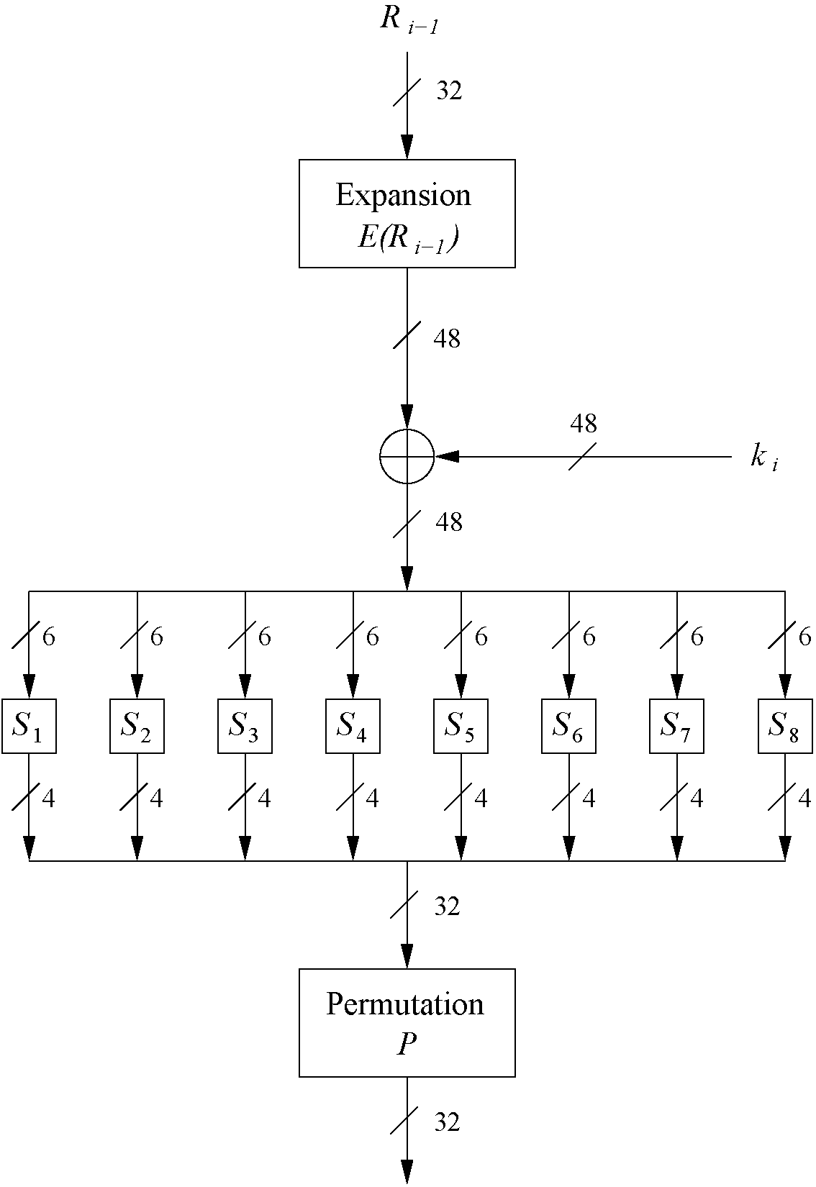
The f-Function
Main operation of DES
f-Function inputs: R_{i-1} and round key k_{i}
4 Steps:
Expansion E
XOR with round key
S-box substitution
Permutation

Slide 16
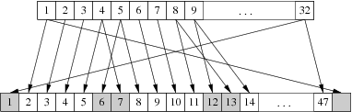
The Expansion Function E
Expansion E
main purpose: increases diffusion
!

Slide 17
XOR Round Key
XOR Round Key
Bitwise XOR of the round key and the output of the expansion function E
Round keys are derived from the main key in the DES keyschedule (in a few slides)

Slide 18
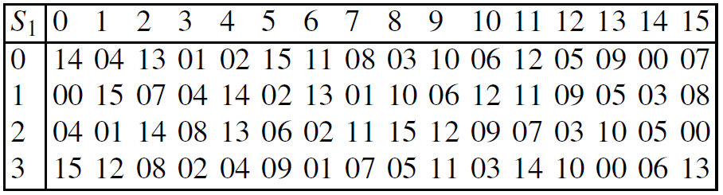
The DES S-Boxes
S-Box substitution
Eight substitution tables
Each S-box maps 6 bits of input
to 4 bits of output
Non-linear and resistant to cryptanalysis
Crucial element for DES security!
Row Index 3
Column Index 2
Notes:
Non-linear and resistant to differential cryptanalysis.
Find all S-Box tables and S-Box design criteria in Understanding Cryptography Chapter 3.
Each S box get input as 6 puts and output to 4 bits, 8*6=48 into 8*4=32

Slide 19
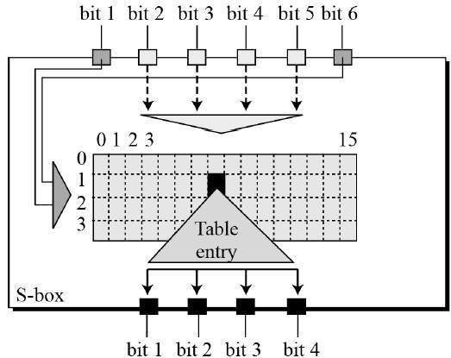
DES S-Box

Slide 20
Design criteria for the S-Boxes
S-boxes were designed according to the criteria listed below.
Each S-box has six input bits and four output bits.
No single output bit should be too close to a linear combination of the input bits.
If the lowest and the highest bits of the input are ﬁxed and the four middle bits are varied, each of the possible 4-bit output values must occur exactly once.
If two inputs to an S-box differ in exactly one bit, their outputs must differ in at least two bits.

Slide 21
Design criteria for the S-Boxes - 2
If two inputs to an S-box differ in the two middle bits, their outputs must differ in at least two bits.
If two inputs to an S-box differ in their ﬁrst two bits and are identical in their last two bits, the two outputs must be different.
For any nonzero 6-bit difference between inputs, no more than 8 of the 32 pairs of inputs exhibiting that difference may result in the same output difference.
A collision (zero output difference) at the 32-bit output of the eight S-boxes is only possible for three adjacent S-boxes.

Slide 22
Non-linearity of S-Boxes
The S-boxes are the most crucial elements of DES because they introduce a non-linearity to the cipher, i.e.,
Without a nonlinear building block, an attacker could not express the DES input and output with a system of linear equations where the key bits are the unknowns.
Such systems can easily be solved.
The S-boxes were carefully designed to also thwart advanced mathematical attacks, in particular differential cryptanalysis.

Slide 23
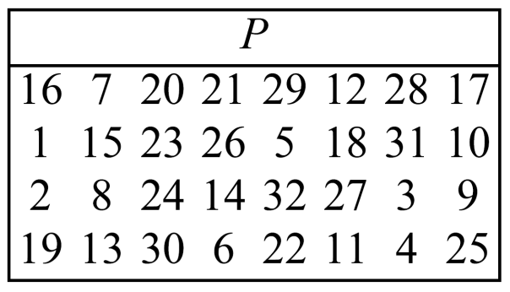
The Permutation P
Permutation P
Bitwise permutation
Introduces diffusion
Output bits of one S-Box affect several S-Boxes in next round
Notes:
Diffusion by E, S-Boxes and P guarantees that after Round 5 every bit is a function of each key bit and each plaintext bit

Slide 24
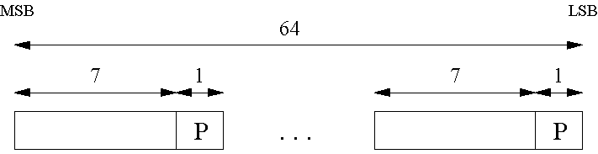
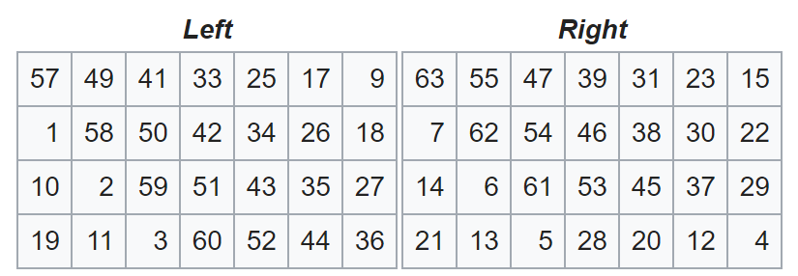
Key Schedule (1)
Derives 16 round keys (or subkeys) k_{i} of 48 bits each from the original 56 bit key
The input key size of the DES is 64 bit: 56 bit key and 8 bit not used:
Permuted Choice (PC-1) is used to permute the key and split it into left-side and right-side (28 bits each). Not that the last bit of every byte is ignored. (the bits 8, 16, 24, 32, 40, 48, 56 and 64 are not used at all)
!
Last bit of every byte is not used
PC-1
Notes:
For applications with long term security needs, 128 bit keys should be considered. For thwarting against attacks with to-be-developed quantum computers, 256 bits are believed to be appropriate. Since a longer key usually does no carry a performance penality for symmetric algorithms, it is a prudent choice to use ciphers with a key lengths of around 128 bits.
For rounds 1, 2, 9 and 16 the shift r_{i} is 1, and in all other rounds r_{i} is 2
Bits 8,17,21,24 of LK omitted each round
Bits 6,9,14,25 of RK omitted each round
Compression permutation yields 48 bit subkey K_{i} from 56 bits of LK and RK
Key schedule generates subkey

Slide 25
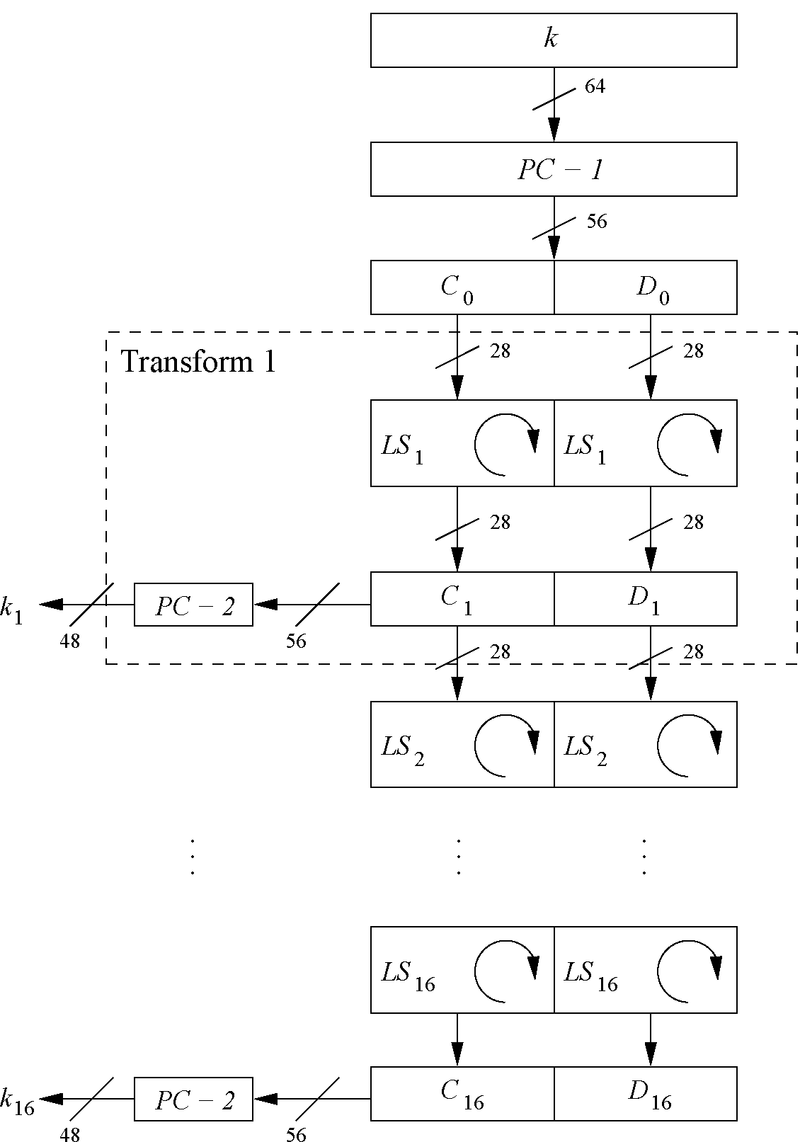
Key Schedule (2)
Split key into 28-bit halves C₀ and D₀
In rounds i = 1, 2, 9 ,16, the two halves are each rotated left by one bit (i.e, Left Circular Shift)
In all other rounds where the two halves are each rotated left by two bits
In each round i Permuted Choice PC-2 selects a permuted subset of 48 bits of C_{i} and D_{i} as round key k_{i}
i.e. each k_{i} is a permutation of k!
Note: The total number of rotations: 4 x 1 + 12 x 2 = 28 ⇒ D₀ = D₁₆ and C₀ = C₁₆!
Notes:
Left Circiular Shift
For applications with long term security needs, 128 bit keys should be considered. For thwarting against attacks with to-be-developed quantum computers, 256 bits are believed to be appropriate. Since a longer key usually does no carry a performance penality for symmetric algorithms, it is a prudent choice to use ciphers with a key lengths of around 128 bits.
For rounds i=1,2,...,16
Let LK = (LK circular shift left by r_{i})
Let RK = (RK circular shift left by r_{i})
Left half of subkey K_{i} is of LK bits
13 16 10 23 0 4 2 27 14 5 20 9
22 18 11 3 25 7 15 6 26 19 12 1
Right half of subkey K_{i} is RK bits
12 23 2 8 18 26 1 11 22 16 4 19
15 20 10 27 5 24 17 13 21 7 0 3

Slide 26
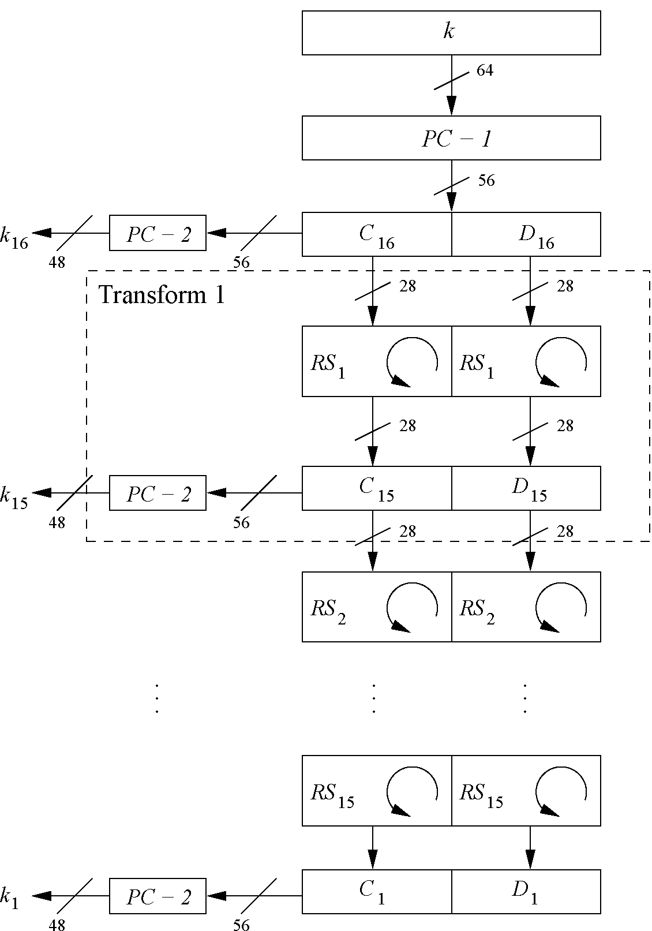
Decryption
In Feistel ciphers only the key schedule has to be modified for decryption
Generate the same 16 round keys in reverse order
Reversed key schedule:
As D₀=D₁₆ and C₀=C₁₆ the first round key can be generated by applying PC-2 right after PC-1 (no rotation here!)
All other rotations of C and D can be reversed to reproduce the other round keys resulting in:
No rotation in round 1.
One bit rotation to the right in rounds 2, 9 and 16.
Two bit rotations to the right in all other rounds.
Notes:
(for a detailed discussion on why this works see Understanding Crptography Chapter 3)
The rule is as follows: Use the ciphertext as input to the DES algorithm, but use the subkeys Ki in reverse order. That is, use K16 on the first iteration, K15 on the second iteration, and so on until K1 is used on the 16th and last iteration.

Slide 27
Security of DES

Slide 28
Security of DES
After the proposal of DES two major criticisms arose:
Key space is too small (2⁵⁶ keys)
S-box design criteria have been kept secret: Are there any hidden analytical attacks (backdoors), only known to the NSA?
Analytical Attacks: DES is highly resistent to advanced cryptanalysis. So far there is no known analytical attack.
Exhaustive key search: For a given pair of plaintext-ciphertext (x, y) test all 2⁵⁶ keys until the condition DES_{k}⁻¹(x)=y is fulfilled. ⇒ Relatively easy given today’s computer technology!
Notes:
differential and linear
developed years after DES. This means IBM and NSA had been aware of these attacks for 15 years! So far there is no known analytical attack
The major weakness of the method is that each plaintext symbol always maps to the same ciphertext symbol. That means that the statistical properties of the plaintext are preserved in the ciphertext. For practical attacks, the following properties of language can be exploited:
Determine the frequencies of every ciphertext letter. The frequency distribution (even of relatively short pieces of encrypted text) will be close to that of the given language in general. In particular, the most frequent letters (for instance, in English: „e“ is the most frequent one with about 13%, „t“ is the second most frequent one with about 9%, „a“ is the third most frequent one with about 8%, ...) can often easily be spotted in ciphertext.
The method above can be generalized by looking at pairs (or triples, or quadruples, or ...) of ciphertext symbols. For instance, in English (and German and other European languages), the letter „q“ is almost always followed by a „u“. This behavior can be exploited for detecting the substitution of the letter „q“ and the letter „u“.
If we assume that word separators (blanks) have been found (which is often an easy task), one can often detect frequent short words such as „the“, „and“, ... , which leaks all the letters in the words involved in those words

Slide 29
DES is still used in many modern day protocols
NTLM Challenge Response is 100% Broken LANMAN and NTLMv1 authentication is virtually the same as MS-CHAPv2 and further outlined the different cases where this method works for performing a 100% break of Windows Authentication.
Defeating PPTP VPNs and WPA2 Enterprise with MS-CHAPv2 At DefCon 20 researcher Moxie Marlinspike released a tool that reduces the handshake to a single DES (Data Encryption Standard) key which is sent to a FPGA password cracking service where it can be broken online in just under one day.

Slide 30
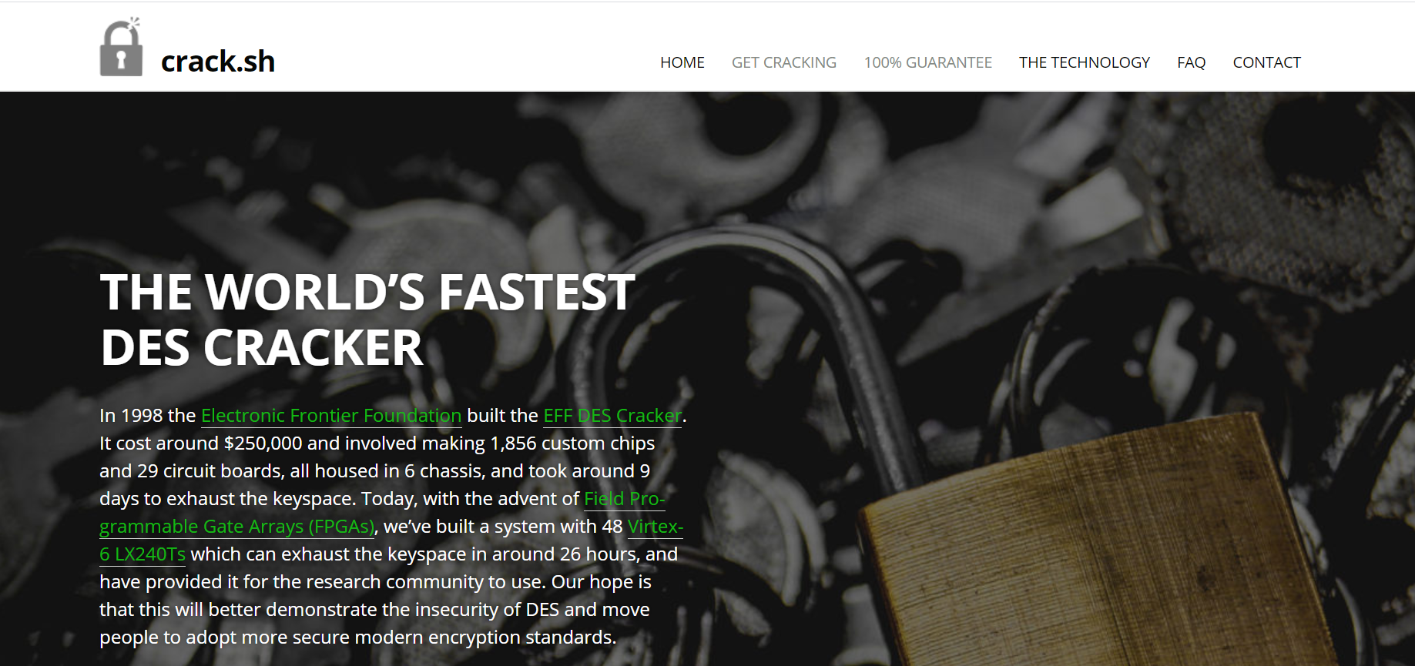
DES Cracking as a Service

Slide 31
Hellman’s TMTO Attack
Time-memory tradeoff attack
Chosen plaintext attack: choose P and obtain C, where C = E(P, K)
Want to find the key K.
Two “obvious” approaches
1. Exhaustive key search “Memory” is 0, but “time” of 2^k-1 for each attack
2. Pre-compute C = E(P, K) for all keys K Given C, simply look up key K in the table “Memory” of 2^k but “time” of 0 for each attack
TMTO lies between 1. and 2.

Slide 32
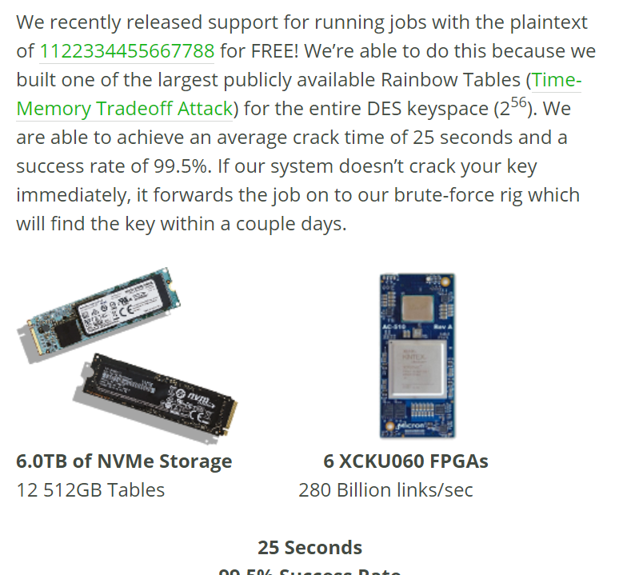
TMTO Attack Success rate
Attack is feasible against DES
Pre-computation is about 2⁵⁶ work
Each attack requires about 2³⁷ “memory” and 2³⁷ “time”
Attack is not particular to DES
NTLMv1 broken in 2 seconds!

Slide 33

Triple DES – 3DES
Triple encryption applies the DES cipher algorithm three times to each data block
Protect against brute-force attacks without the need to design a completely new block cipher (just by effective key length up to 168 bits)
No practical attack known today
Used in some legacy applications such as in banking systems but slow
Notes:
Alternative version of 3DES:
Advantage: choosing k₁=k₂=k₃ performs single DES encryption.
Using DES is often used in practice to extend the effective key length of DES to 112. For more info on multiple encryption and effective key lengths see Chapter 5 of Understanding Cryptography.

Slide 34
Alternatives to DES
Algorithm | I/O Bit | Key lengths | Remarks
AES | 128 | 128/192/256 | DES replacement, worldwide used standard
Triple DES | 64 | up to 168 bits | Used for legacy applications
Mars | 128 | 128/192/256 | AES finalist
RC6 | 128 | 128/192/256 | AES finalist
Serpent | 128 | 128/192/256 | AES finalist
Twofish | 128 | 128/192/256 | AES finalist
Notes:
/ Rijndael
IDEA
64
128
(Patented till 2011)

Slide 35
Summary
DES was the dominant symmetric encryption algorithm from the mid-1970s to the mid-1990s. Since 56-bit keys are no longer secure, the Advanced Encryption Standard (AES) was created
Standard DES with 56-bit key length can be broken relatively easily nowadays through an exhaustive key search
DES is robust against analytical attacks. Its security depends heavily on S-boxes
By encrypting with DES three times in a row, triple DES (3DES) is created, against which no practical attack is currently known
The default symmetric cipher is nowadays often AES
Notes:
In addition, the other four AES finalist ciphers all seem very secure and efficient.
Today, 56 bit DES key is too small
Exhaustive key search is feasible
Security depends heavily on S-boxes
35+ years of intense analysis has revealed no back door
Attacks, essentially exhaustive key search
Key conclusions
Designers of DES knew what they were doing
Designers of DES were way ahead of their time (at least regarding certain cryptanalytic techniques)
DES is quite robust against known analytical attacks: In practice it is very difficult to break the cipher with differential or linear cryptanalysis
§▪ Confidentiality
o□ Encrypt message with symmetric
o□ Encrypt key with public
§▪ Authenticity
o□ Compute digest with hash
o□ Encrypt digest with private

Slide 36
Resources
DES Animation
http://kathrynneugent.com/des.html
DES Wikipedia page
https://en.wikipedia.org/wiki/Data_Encryption_Standard
DES Tool
http://des.online-domain-tools.com/
Notes:
AES Animation http://www.formaestudio.com/rijndaelinspector/archivos/rijndaelanimation.html

